Slide 1

Authentication
Authentication – who are you?
Users
Passwords
Tokens

Slide 2
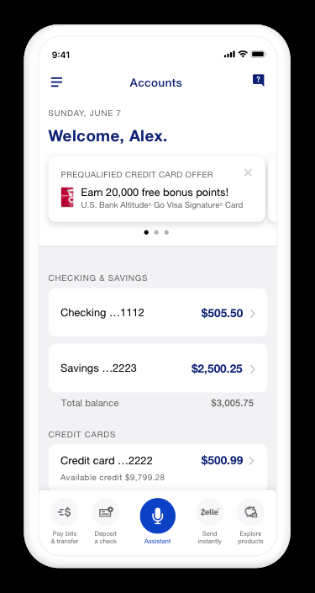


HTTPS "handshake"
HTTPS is designed to prove identity *and* encrypt
2
Notes:
For simplicity omitting some details, but this is the overall idea. Take a security class for more details ☺
On Windows, run "CertMgr" to view local certificate storage

Slide 3






HTTPS "handshake"
HTTPS is designed to prove identity *and* encrypt
Notes:
For simplicity omitting some details, but this is the overall idea. Take a security class for more details ☺

Slide 4
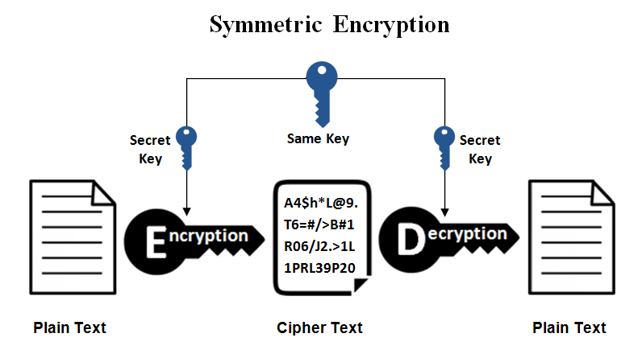
Symmetric encryption
After HTTPS handshake, client and server exchange a single key for faster symmetric encryption
Single key can be used by both parties to encrypt & decrypt
4

Slide 5
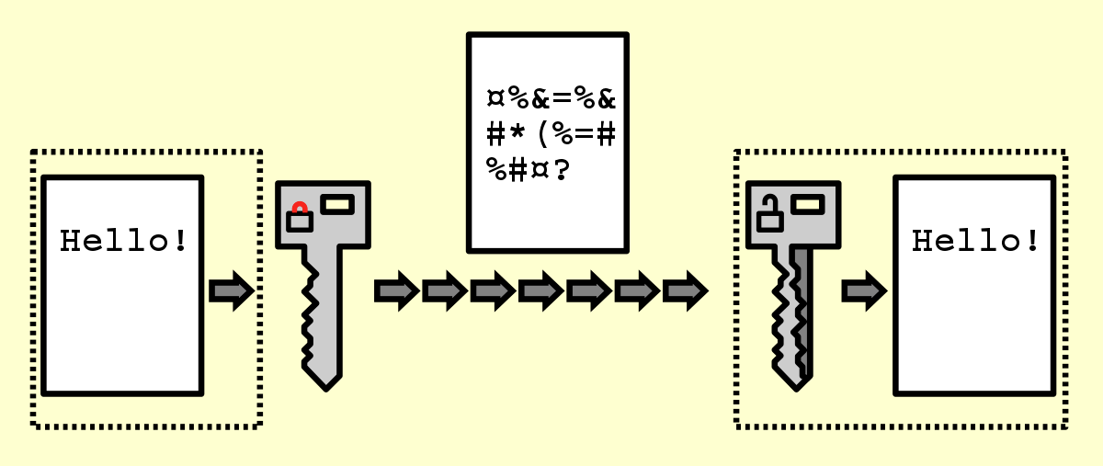











Symmetric encryption
After HTTPS handshake, client and server exchange a single key for faster symmetric encryption
5

Slide 6
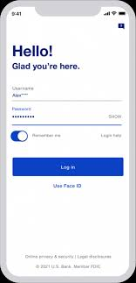
User authentication
Now that we have a secure connection…
The user needs to prove their identify
6

Slide 7
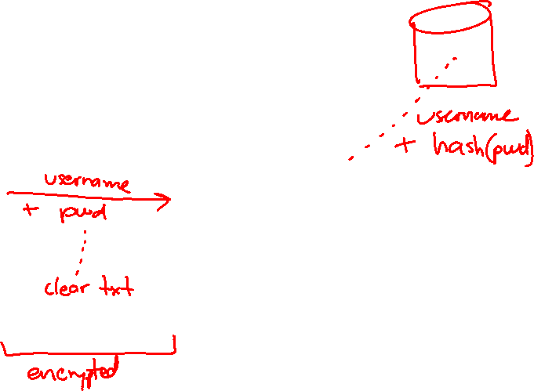
User authentication
Now that we have a secure connection…
The user needs to prove their identify
7

Slide 8
API calls
Every API call needs to identify the user, and carry proof of their identify…
otherwise you could access any account you want!
8

Slide 9
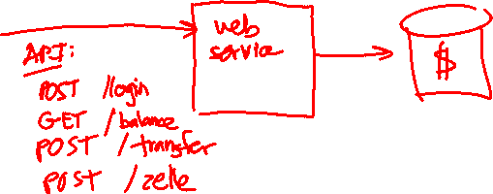
API calls
Every API call needs to identify the user, and carry proof of their identify…
otherwise you could access any account you want!
9

Slide 10
Approach #1
Send username and password…
Requires storing password or prompting each time
10

Slide 11
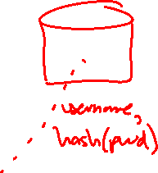
Approach #1
Send username and password…
Requires storing password or prompting each time
11

Slide 12
Approach #2
Login yields an access token
Access token is used for identification
Token can be set to expire after time period (short or long)
12
Notes:
Risk trade-off… Your login can stay active for hours / days / weeks… Or logout and the token is discarded, up to you.

Slide 13
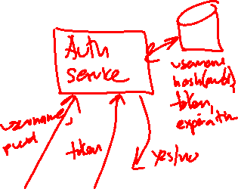
Approach #2
Login yields an access token
Access token is used for identification
Token can be set to expire after time period
13

Slide 14
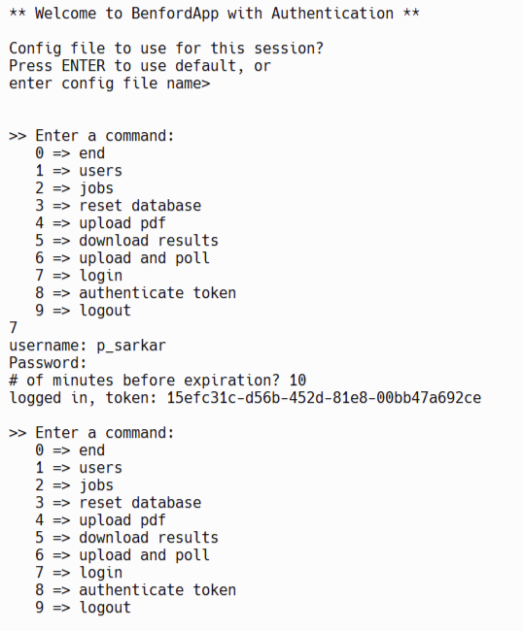
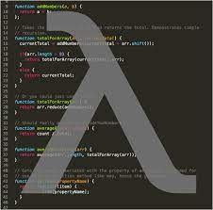
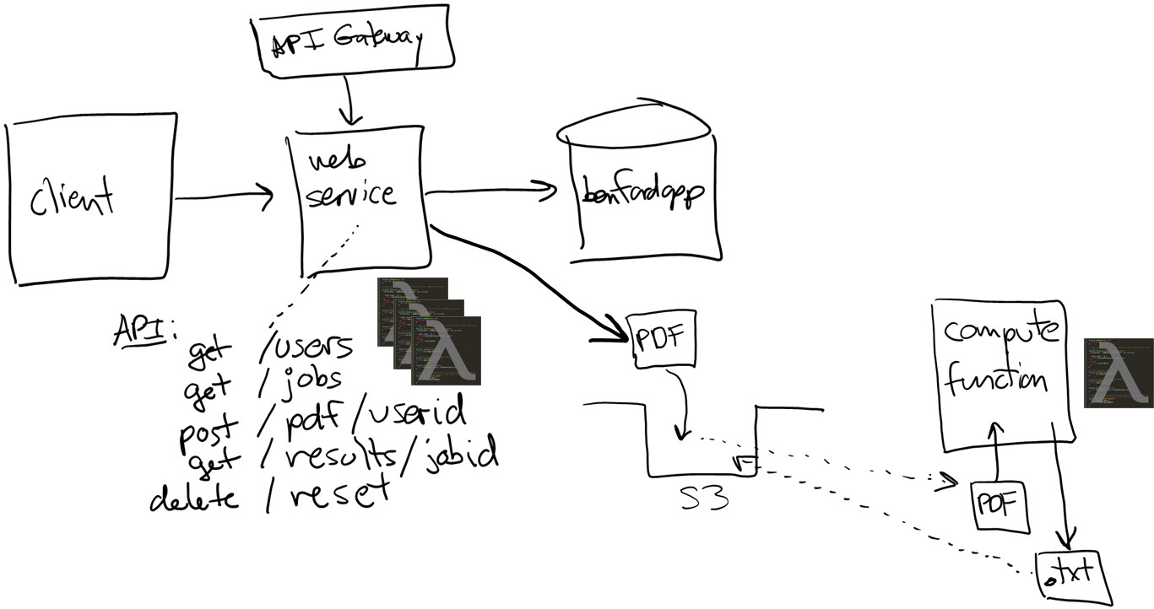



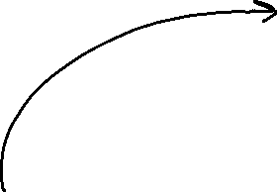







Example: project 04

Slide 15
Approach #3
Login yields a stateless token
Token itself contains all necessary info --- nothing on server
Encrypted using server's private key at login, API functions use public key to validate --- avoids API functions calling auth service
Example: JSON Web Tokens (JWT)
15

Slide 16
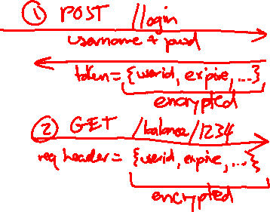
Approach #3
Login yields a stateless token
Token itself contains all necessary info --- nothing on server
Encrypted using server's private key at login, API functions use public key to validate --- avoids API functions calling auth service
Example: JSON Web Tokens (JWT)
16

Slide 17
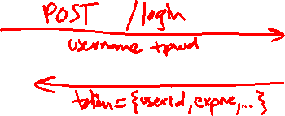
Question
Login yields a stateless token…
Can the client modify the token? Change the userid or expiration?
No! But why not?
17
Notes:
Because if they modify, they have to re-encrypt the token --- and they don't have the private key to do that. So when client sends token back over to the server, it will fail validation on the server-side.

Slide 18
That's it, thank you!

